Slide 1
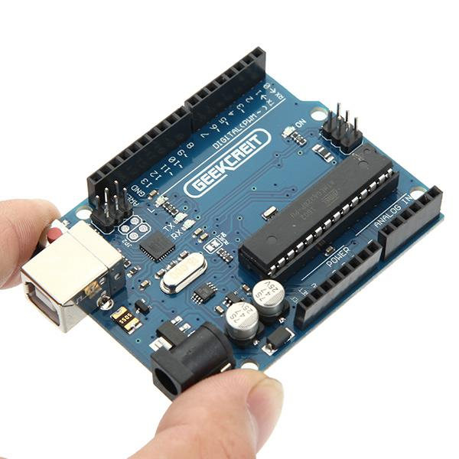
An Introduction the Arduino
Peter Beens,
DSBN 2016
@pbeens
URL for this presentation: https://goo.gl/97LryV
Image courtesy of http://goo.gl/8nJroG

Slide 2
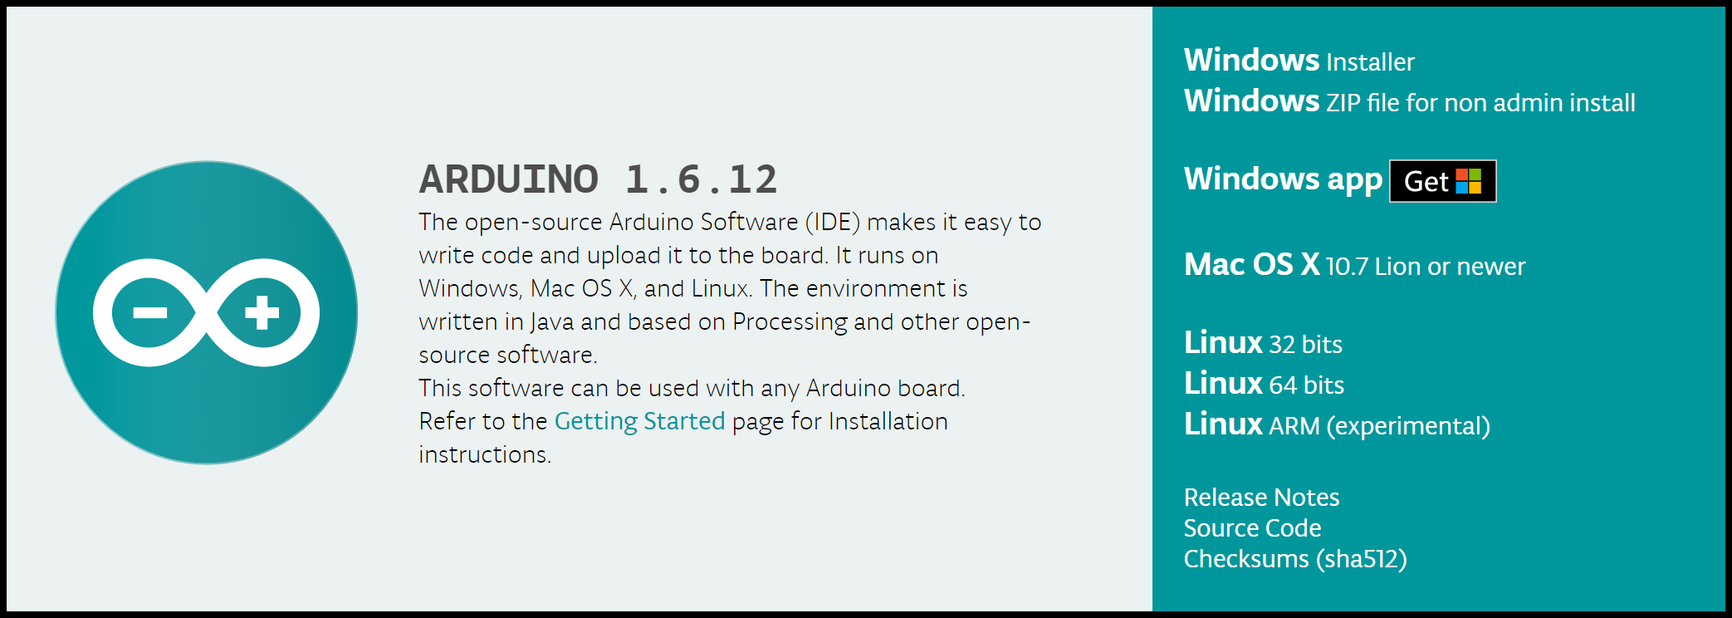
https://www.arduino.cc/

Slide 3
Arduino is an open-source electronics platform based on easy-to-use hardware and software.
Credit: https://www.arduino.cc/en/Guide/Introduction

Slide 4
Can read inputs (e.g., light sensor, button, a Tweet) and provide outputs (e.g., activate a motor, turn on an LED, make sounds, send a Tweet, put characters on an LCD display)

Slide 5
Can be used to learn about electronics and programming (ideal for Computer Technology or Maker Clubs and a great way to make CS more fun)
Interesting fact: Arduino programs are called "sketches", not programs
Credit: https://en.wikipedia.org/wiki/Arduino

Slide 6
Intro Videos

Slide 7
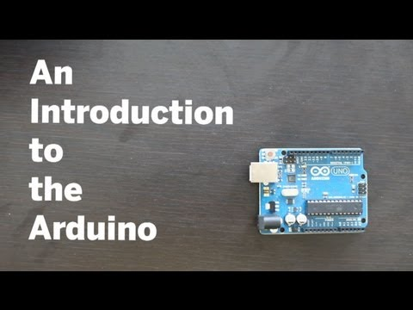
An Introduction to the Arduino (from Make Magazine) (4:25)
https://www.youtube.com/watch?v=CqrQmQqpHXc

Slide 8
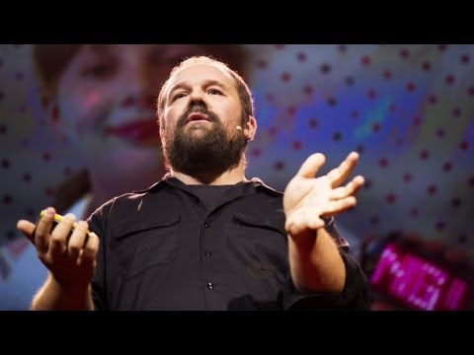
Massimo Banzi: How Arduino is open-sourcing imagination (15:46)
https://www.youtube.com/watch?v=UoBUXOOdLXY

Slide 9

“Tutorial 01 for Arduino: Getting Acquainted with Arduino” (14:31)
https://www.youtube.com/watch?v=fCxzA9_kg6s

Slide 10
Our First Program!

Slide 11
“Empty Program”
This program will allow you to:
See the basic functions of an Arduino program
Learn how to configure the editor (IDE) for the Arduino
Learn how to check the syntax of a program
Learn how to upload the program into the Arduino

Slide 12
Save as “Empty”
void setup() {
}
void loop() {
}
Note!
Save the code for all your programs in a folder named “Arduino” in your home folder.

Slide 13
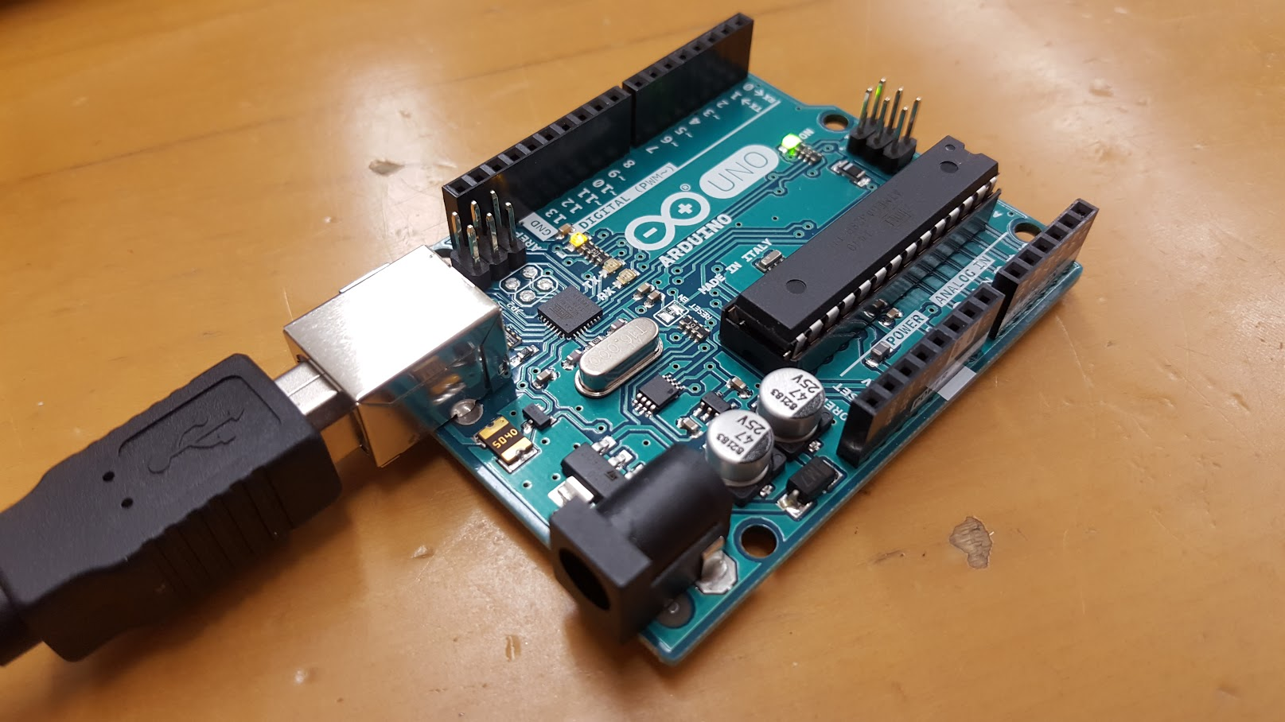
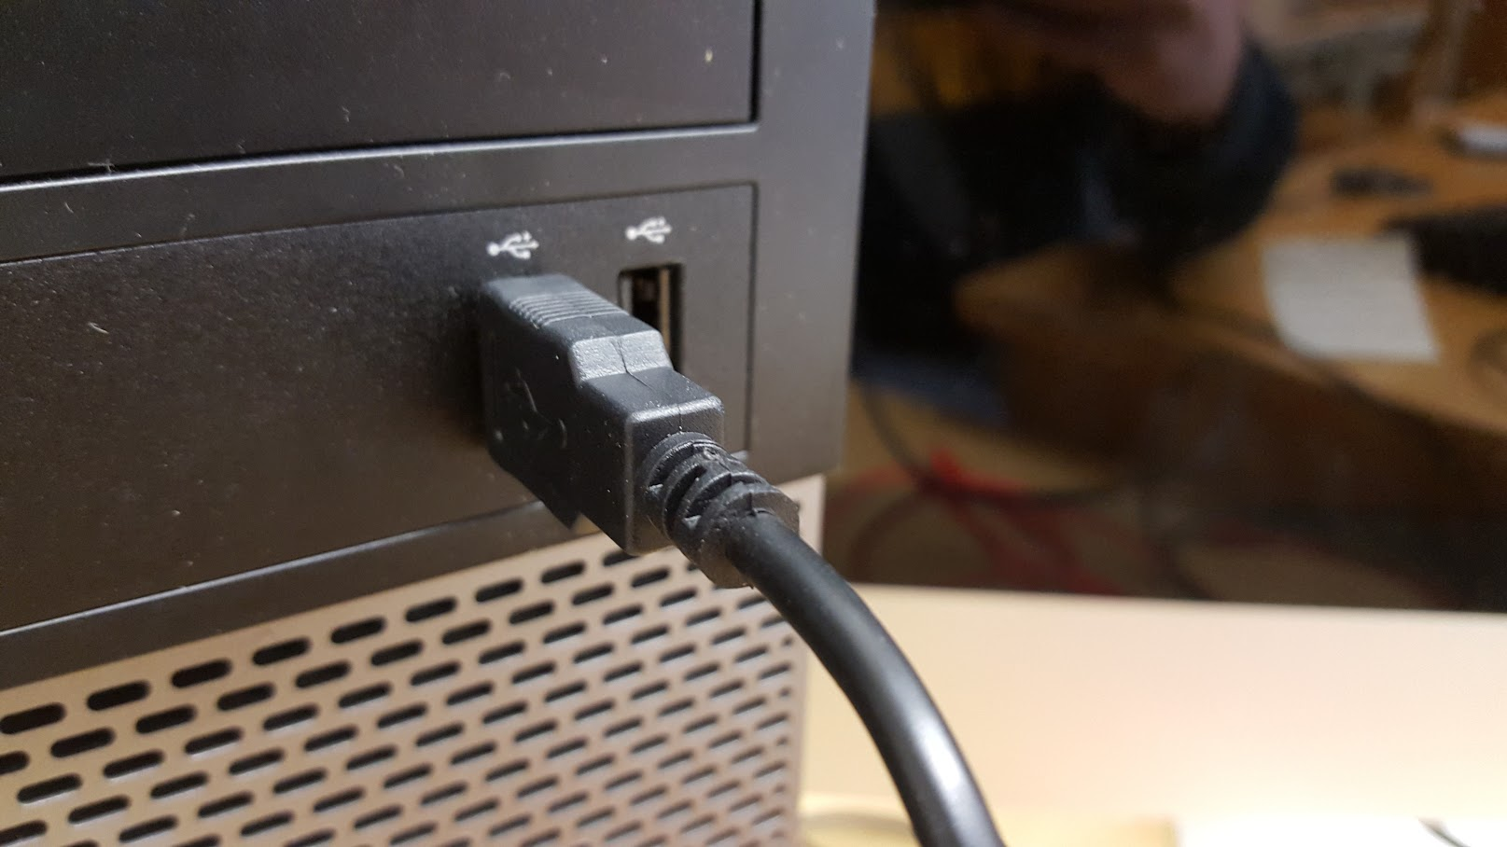
Connect Your Arduino...

Slide 14
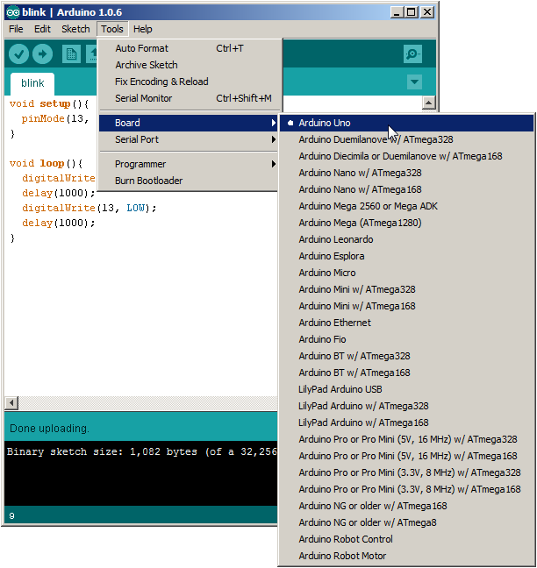
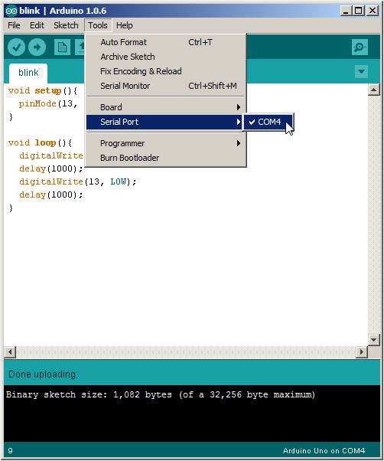
Before Uploading...

Slide 15
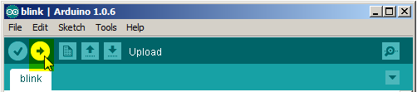
Upload!
Watch the LEDs on the Arduino while the program is uploading...

Slide 16
Program #2: “Blink”

Slide 17
“Blink”
This program turns on an LED on for one second, then off for one second, repeatedly.
Most Arduinos have an on-board LED you can control. On the Uno and Leonardo, it is attached to digital pin 13.
Credit(s): http://labs.arduino.org/STARTER+KIT+-+GET+TO+KNOW+YOUR+TOOLS

Slide 18
Save as “Blink”
// the setup function runs once when you press reset or power the board
void setup() {
// initialize digital pin 13 as an output.
pinMode(13, OUTPUT);
}
// the loop function runs over and over again
void loop() {
digitalWrite(13, HIGH); // turn the LED on
delay(1000); // wait for a second
digitalWrite(13, LOW); // turn the LED off
delay(1000); // wait for a second
}
Note!
The highlighted comments are not necessary for your program, but it’s good programming practice for you to include lots of them to help document your program.
Credit(s): http://labs.arduino.org/STARTER+KIT+-+GET+TO+KNOW+YOUR+TOOLS

Slide 19
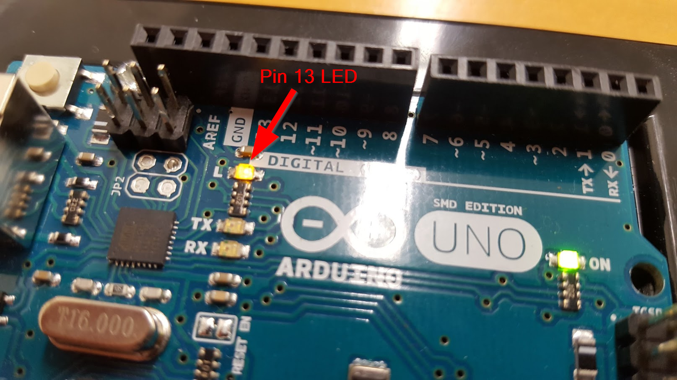
Did it Work?!!

Slide 20
Some Arduino Programming Basics

Slide 21
Note!
The #1 rule in programming is:
Save Early, Save Often!

Slide 22

Variables
A variable is a place for storing a piece of data. It has a name, a type, and a value.
Example:
Credit(s): http://labs.arduino.org/What+is+a+Sketch

Slide 23
Variables (cont’d)
This example declares a variable with the name ledPin, the type int, and an initial value of 13.
It's being used to indicate which Arduino pin the LED is connected to.
Every time the variable “ledPin” appears in the code, its value will be retrieved (i.e. the value 13).
Credit(s): http://labs.arduino.org/What+is+a+Sketch

Slide 24
Program #3: Blink with a Variable

Slide 25
Task:
Modify your Blink program by inserting the ledPin declaration (as shown below) and substituting “13” with “ledPin” everywhere in your program.
The declaration line should go above the setup() function.
Don’t forget to save your program!

Slide 26
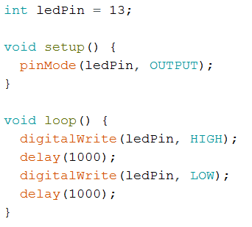
Your code should look like this:

Slide 27
Let’s Hook Up an External LED!

Slide 28
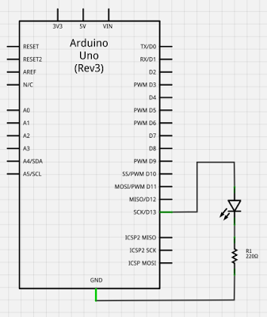
Schematic
The resistor is needed to protect the LED. It limits the current to a safe amount and drops the voltage across the LED to about 2 volts.
Image source: http://www2.beens.org/computer-technology/arduino/activities/blinking-led

Slide 29
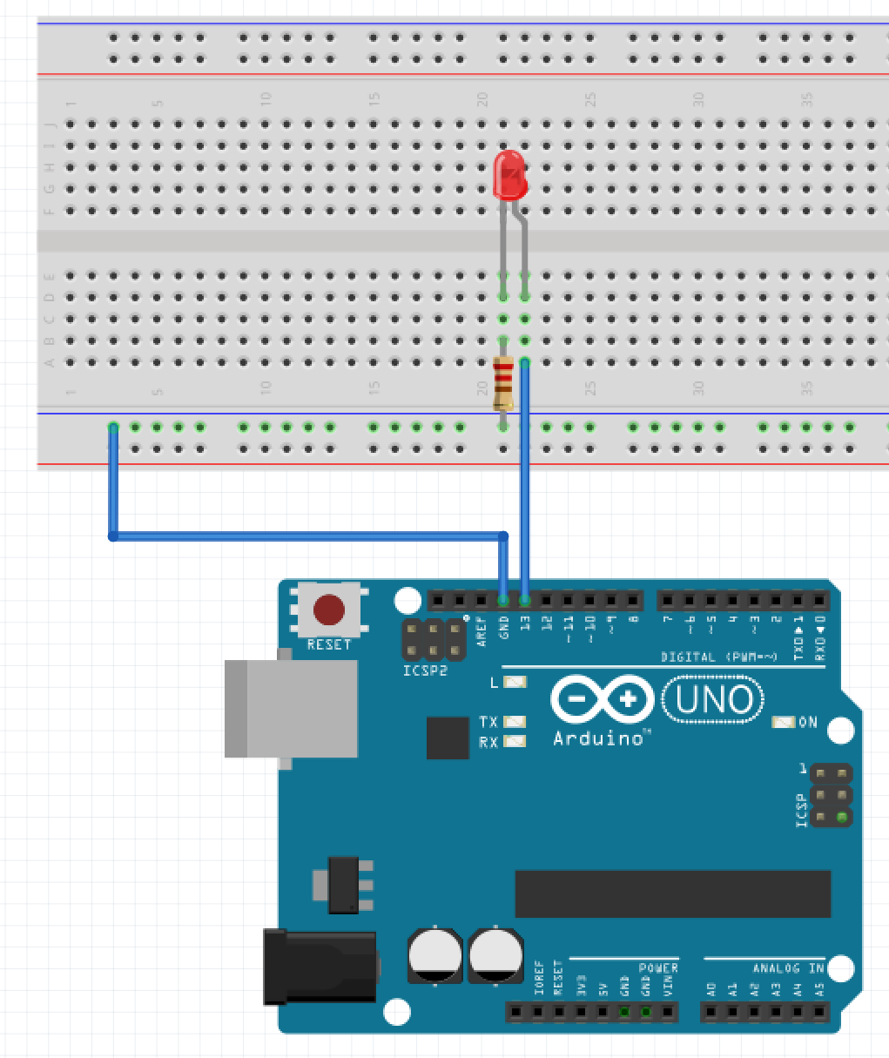
Pictorial
Note!
Unplug your Arduino while hooking up the electronic components. Get the circuit checked before applying power.
Image source: http://www2.beens.org/computer-technology/arduino/activities/blinking-led

Slide 30
Program #4: A Traffic Light

Slide 31
Let’s Build a Traffic Light!
Save your Blink program as “TrafficLight”.
Modify “ledPin” to be “redLED” throughout your program.
Add two variables “yellowLED” and “greenLED”, using pins 12 and 11, respectively.
Modify your program and your circuitry to simulate a traffic light. There should be no delay between each LED being lit.

Slide 32
Program #5, 6, and 7: 8 LEDs

Slide 33
8 LED Circuit and Programs
First, wire up 8 LEDs. Remember that each LED requires its own resistor. For convenience, use pins 6-13. (Hint: use pin 6 for LED 1, 7 for LED 2, etc.)
Program 5: Simply flash all 8 LEDs on and off.
Program 6: Light the LEDs in sequence.
Program 7: Create a binary counter, with each LED representing one bit in a byte.

Slide 34
Supplemental Material

Slide 35
Fritzing
“Fritzing is an open-source hardware initiative that makes electronics accessible as a creative material for anyone. We offer a software tool, a community website and services in the spirit of Processing and Arduino, fostering a creative ecosystem that allows users to document their prototypes, share them with others, teach electronics in a classroom, and layout and manufacture professional PCBs.”
http://fritzing.org

Slide 36
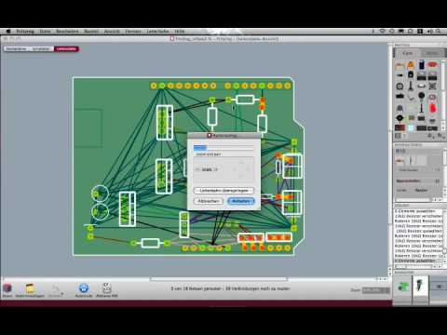
Fritzing cont’d

Slide 37
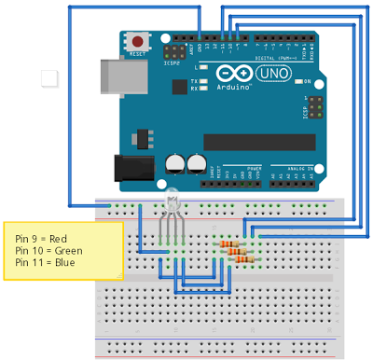
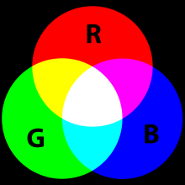
From a Traffic Light to RGB!
Assignment
Write a program that loops through the following colours, with each colour being displayed for 500 mS:
green
yellow
red
magenta
blue
cyan
white
Frtizing diagram source: http://www2.beens.org/computer-technology/arduino/activities/rgb-leds
RGB image source: http://upload.wikimedia.org/wikipedia/commons/thumb/c/c2/AdditiveColor.svg/220px-AdditiveColor.svg.png

Slide 38
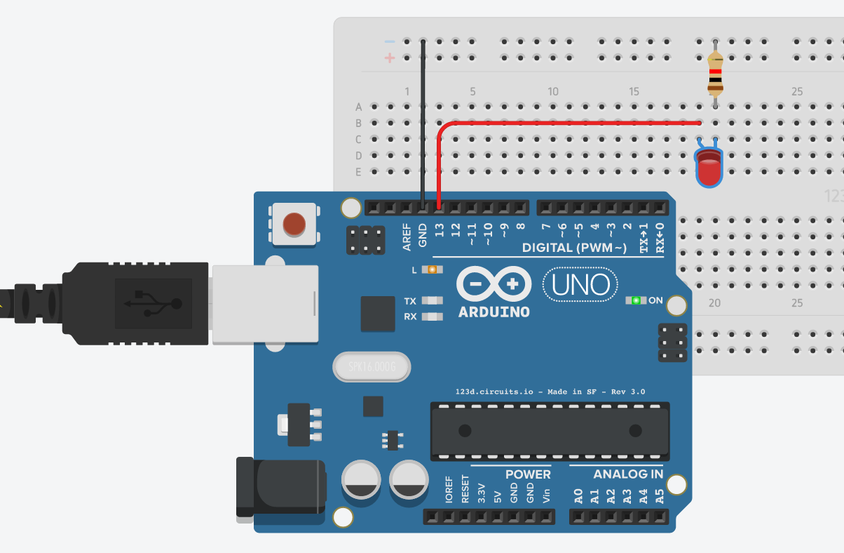
Further Exploration:
Electronics and Arduino simulator https://circuits.io/

Slide 39
Further Exploration (cont’d):
Arduino Tutorials http://www.arduino.org (Learning tab)
Arduino Reference https://www.arduino.cc/en/Reference

Slide 40
My Electronics Presentation
https://goo.gl/cfO08H
(on GitHub)

Slide 41
Thanks!
Follow Up questions or comments? Email me at pbeens@gmail.com.

